Slide 1
Model Evaluation –
Overfitting
-

Slide 2
Overview
Overfitting vs Underfitting
Underfitting to Overfitting in Prediction(Regression)
Underfitting to Overfitting in Classification
Impact of Overfitting on Performance
Approaches to reduce Overfitting
Summary

Slide 3
Terminology
Signal: It refers to the true underlying pattern of the data that helps the machine learning model to learn from the data.
Noise: Noise is unnecessary and irrelevant data that reduces the performance of the model.
Bias: Bias is a prediction error that is introduced in the model due to oversimplifying the machine learning algorithms. Or it is the difference between the predicted values and the actual values.
Variance: If the machine learning model performs well with the training dataset, but does not perform well with the test dataset, then variance occurs.

Slide 4
What is Overfitting
ML models can generalize and produce relationships (models) between predictor where the ‘fit’ maybe excellent.
highly complex explanations of variables and response variable
However, when used with new unseen data, models of great complexity may not do so well!
Overfitting happens when a model learns the details and also noise in the training data to the extent that it negatively impacts the performance of the model on new data. (excellent performance on training, but poor generalization on new data).
Overfitting produces poor predictive performance – past a certain point, the error rate on new data starts to increase
Conversely, Underfitting occurs when the model fails to capture or generalize the underlying pattern in the data, mostly due to over-simplicity of the model. (poor performance on training as well as poor generalization on new data)

Slide 5
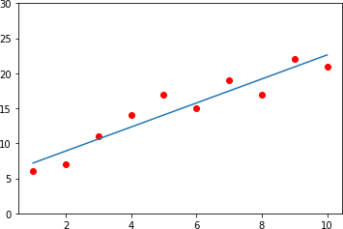
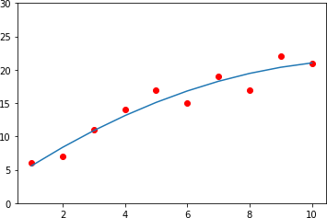
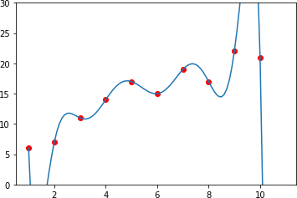
Underfitting to Overfitting – Prediction (Regression)
Given a dataset, where
X = [1, 2, 3, 4, 5, 6, 7, 8, 9, 10] and
y = [6, 7, 11, 14, 17, 15, 19, 17, 22, 21]
y
X
Linear Model
X
Quadratic Model
X
Polynomial Model
y = aX + c
y = a₁X + a₂X² + c
y = a₁X+a₂X²+a₃X³+a₄X⁴+a₅X⁵+a₆X⁶+a₇X⁷+a₈X⁸+ a₈X⁸+c
` Zero
Accuracy: 89.5 %
Accuracy: 93%
Accuracy: 99.99%
Error
Simple
Complex
Underfitting (High Bias)
Just Fit
Overfitting (High Variance)

Slide 6
Underfitting to Overfitting – Classification
X₂
X₂
X₂
` Zero Error
X
1
X
1
X₁
Simple
Complex
Underfitting (High Bias)
Just Fit
Overfitting (High Variance)

Slide 7
Impact of Overfitting on Performance
Training Test
Error
Underfitting
Overfitting
Model Complexity

Slide 8
Approaches to reduce Overfitting
Partitioning the available data into Training – Validation – Test partitions and performing Cross Validation
Reducing the number of features used in building the model
Regularization

Slide 9
Summary
Overfitting : excellent performance on training data, but poor generalization on new data. Also known as High Variance
Underfitting : Poor performance on training as well as poor generalization on new data. Also known as High Bias
Complex models with zero error typically end up overfitting
Partitioning of data into Training-Validation-Test partitions for cross validation, reducing number of features, regularization, etc., are some of the techniques to reduce the impact of overfitting

Slide 10
References
https://towardsdatascience.com/overfitting-vs-underfitting-a- complete-example-d05dd7e19765
https://chunml.github.io/ChunML.github.io/tutorial/Underfit-Overfit/
https://machinelearningmastery.com/overfitting-and-underfitting- with-machine-learning-algorithms/
https://keeeto.github.io/blog/bias_variance/

